Slide 1
One-Shot Learning
Ahmad Zubair
Umair Yousaf

Slide 2
Methodology
Training:
The Siamese Network (identical twins) generates a “fingerprint” of the input image
Anchor, Positive, Negative (Triplet Loss)
Push instances with similar fingerprints closer together
Pull instances with different fingerprints farther apart
Testing:
Generate a set of average “fingerprints” of each class called the support set
Find euclidean distance with each of the average fingerprints, then classify

Slide 3
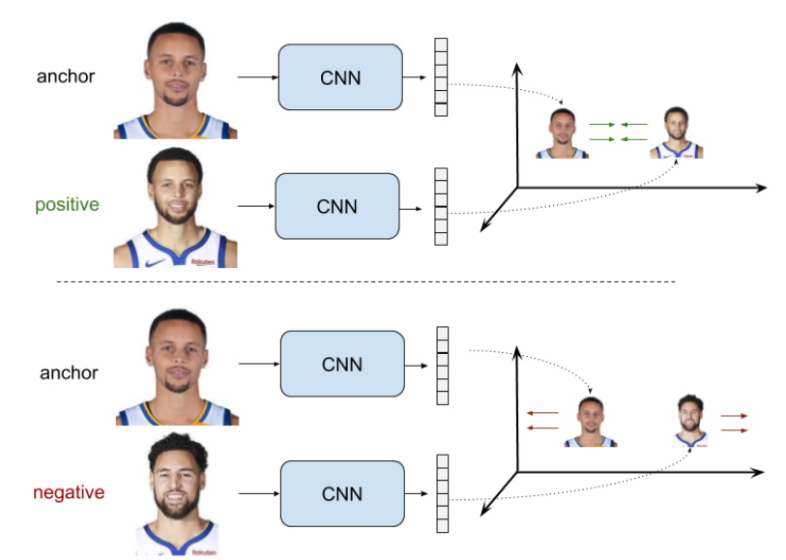

Slide 4
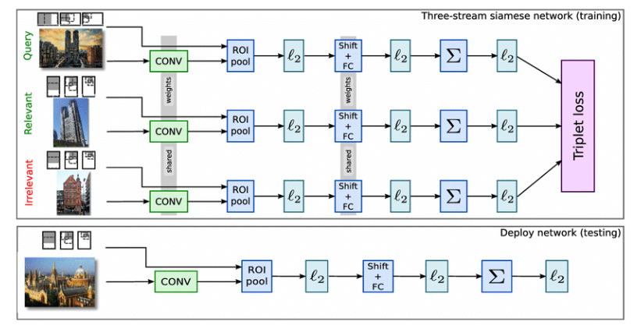

Slide 5
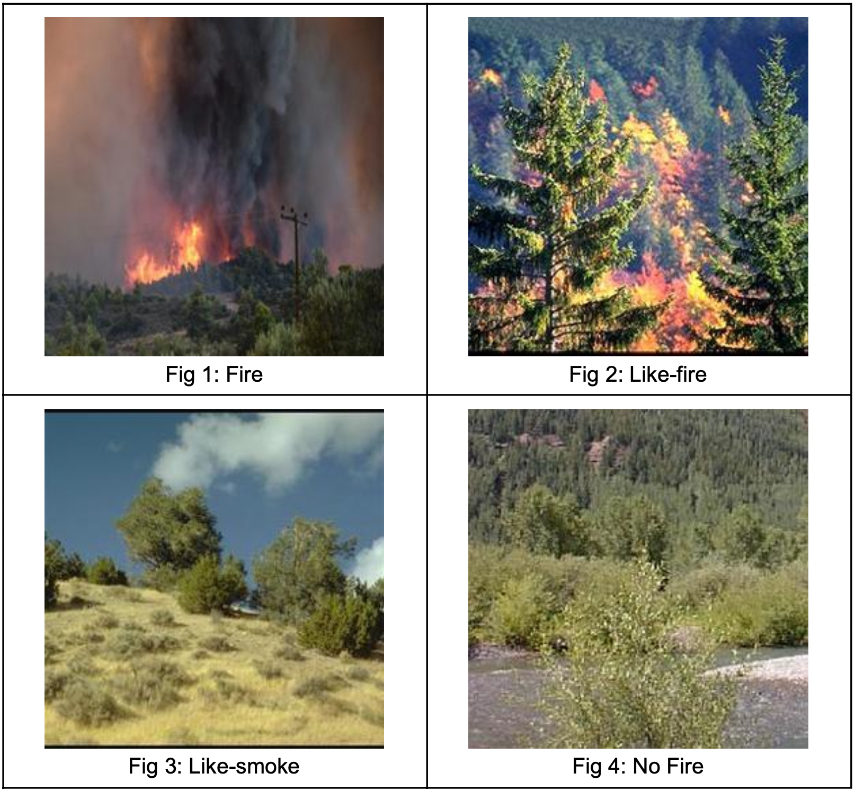
Dataset
The Mendely dataset was used.
Split into 4 classes:
Fire
Like-Fire
Like-Smoke
No-Fire
250x250 images
212 training instances
78 testing instances

Slide 6
Advantages & Disadvantages
Advantages of One Shot:
Very small dataset required
Training time per epoch is low (~5 sec)
RAM usage is low (dependent on size of network)(our network was small)
Disadvantages:
Need to curate dataset

Slide 7
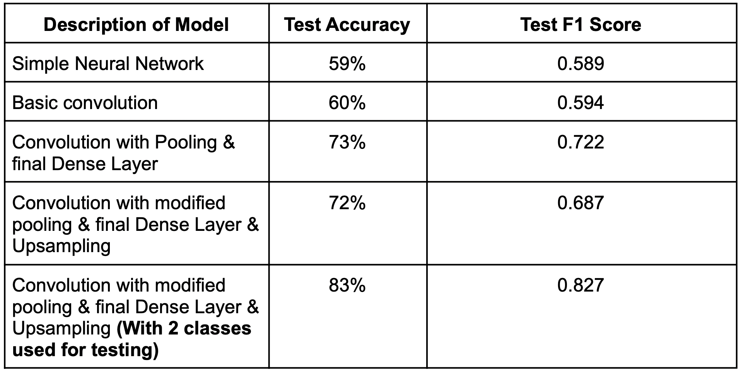
Results
Hyperparameters:
Epochs = 50
Margin (for triplet loss) = 25,000
Learning rate = 0.0001
Optimizer = Adam
Not comparable in performance to state of the art models, at least in our implementation.
Can be improved by:
Using/creating a carefully curated dataset as per its deployment, which also contains “extreme triplets”

Slide 8
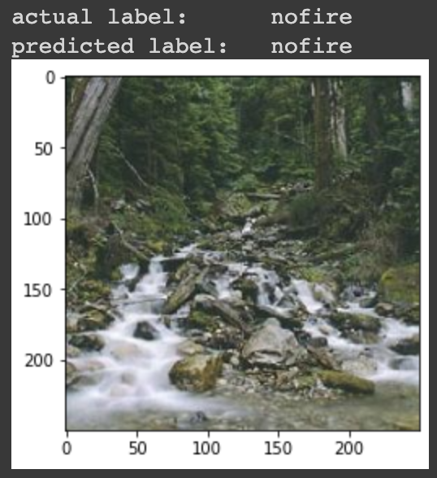
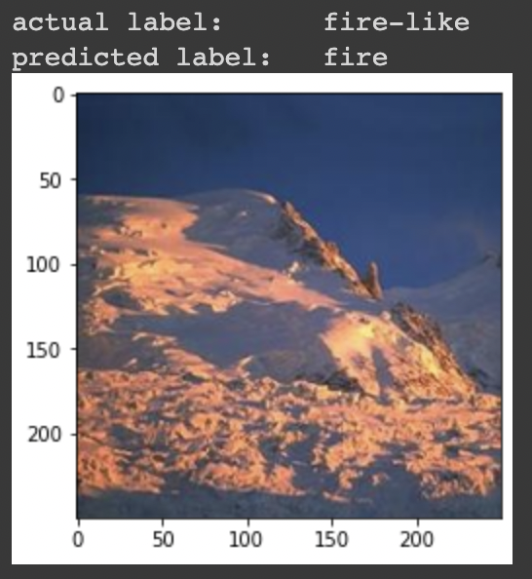
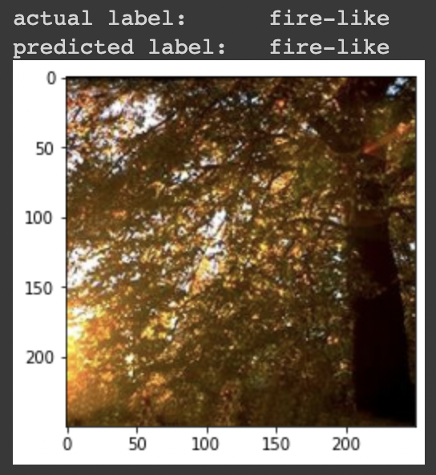
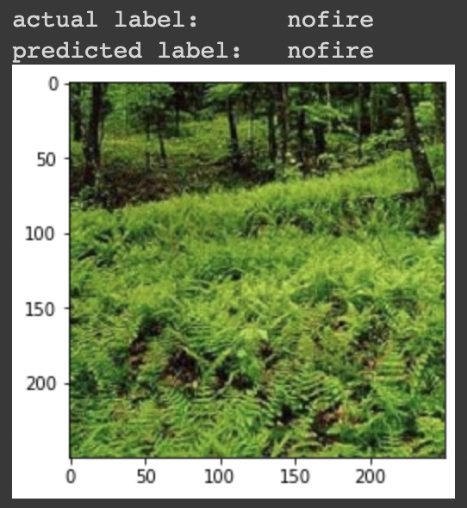
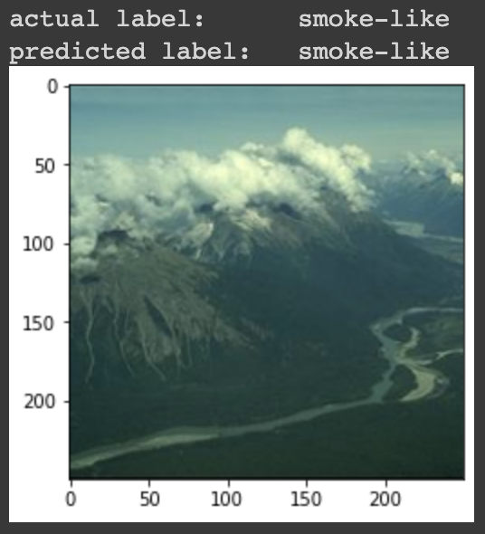
Model Outputs Visualized

